Slide 1


# Machine Learning Flow and Prefect for Tracking Experiments
Raja sekhar Rapaka
https://github.com/RajasekharRapaka

Slide 2
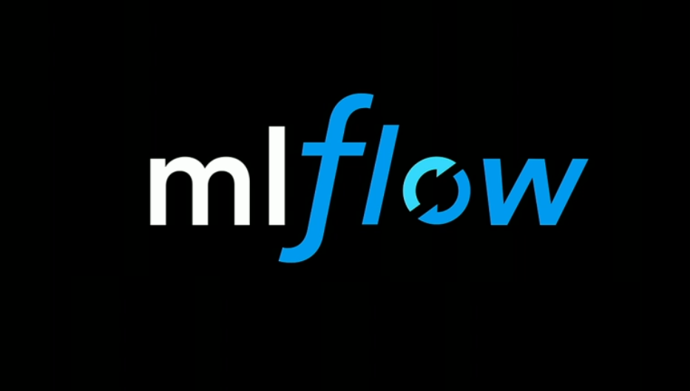
MLflow provides an open-source platform to track every aspect of your machine learning experiments. Log parameters, code, and results to ensure reproducibility, facilitate collaboration, and confidently select the best-performing models for deployment.
http://127.0.0.1:5000/

Slide 3
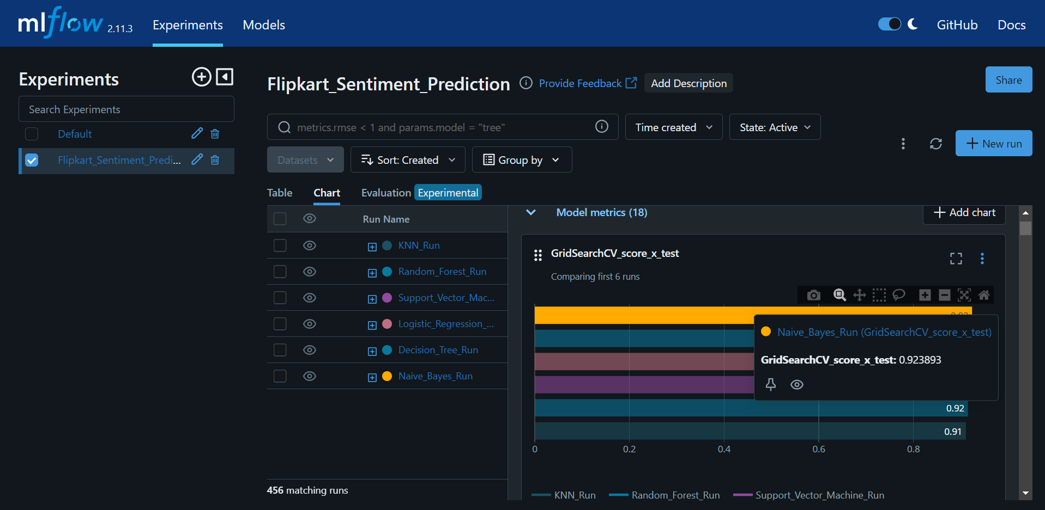
ML Flow interactive UI

Slide 4
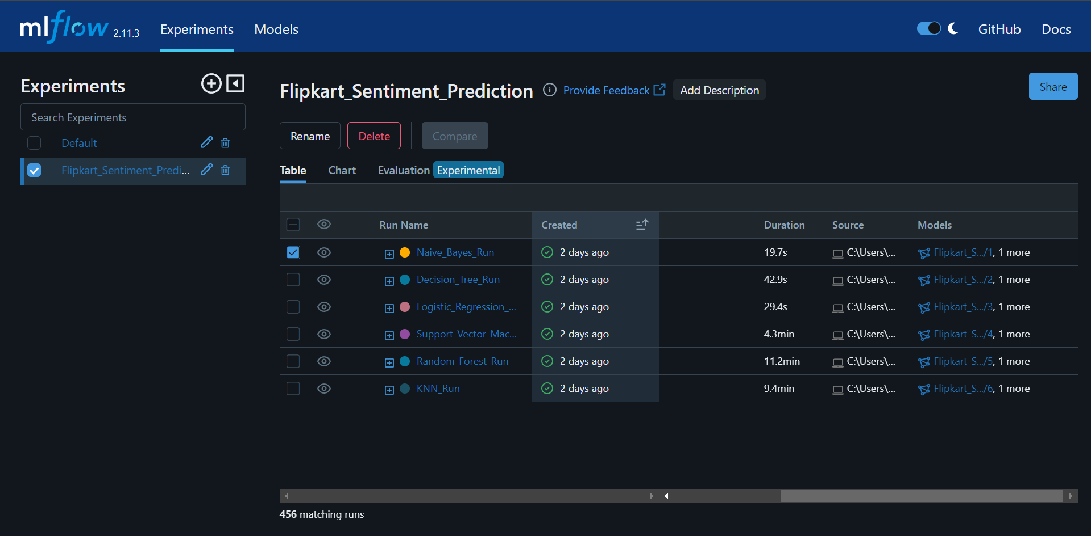
Renaming run names with appropriate models

Slide 5
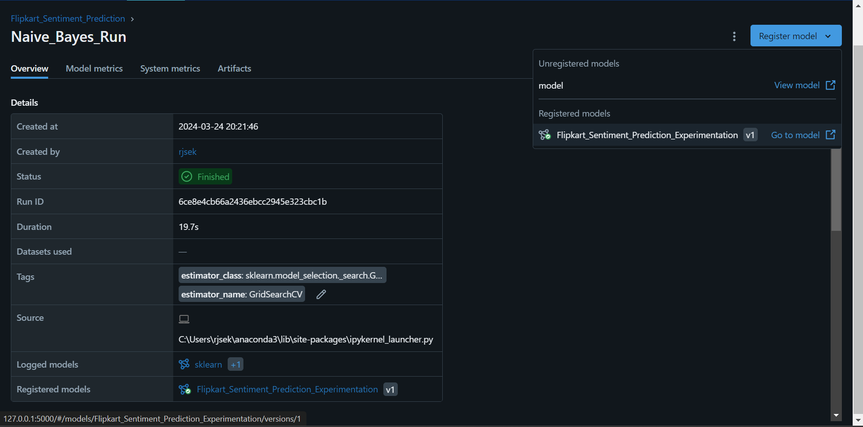
Registering best models

Slide 6
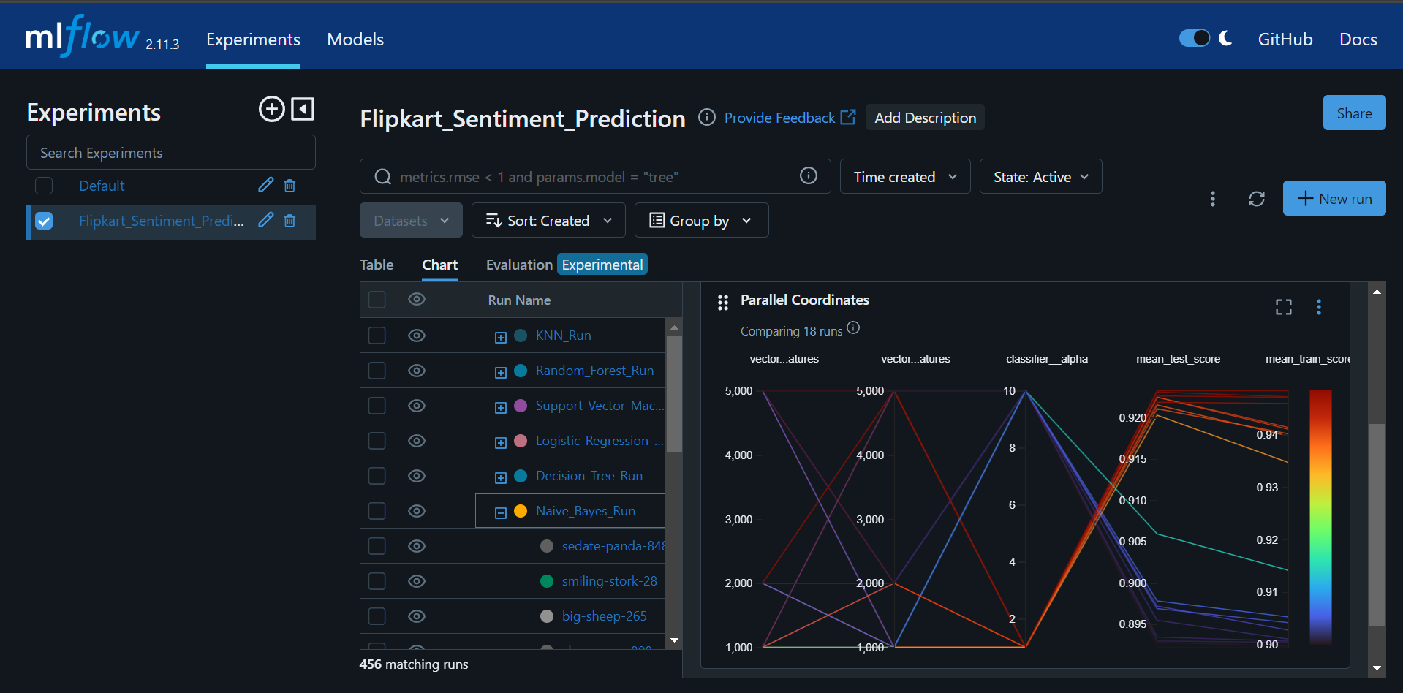
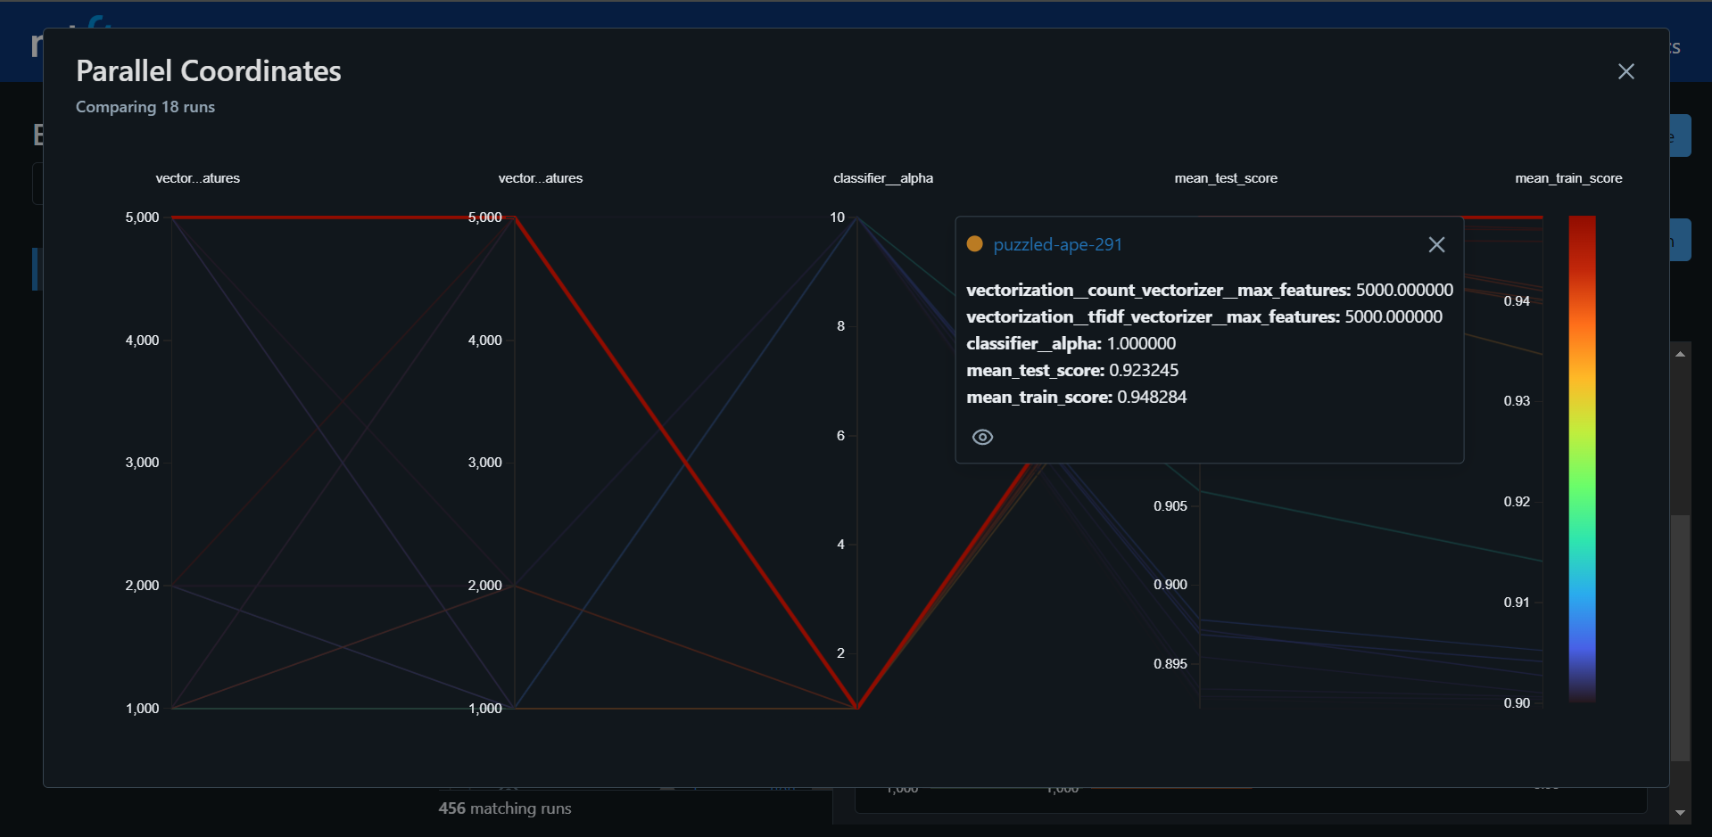
Choosing best models for production based on model’s
performance

Slide 7
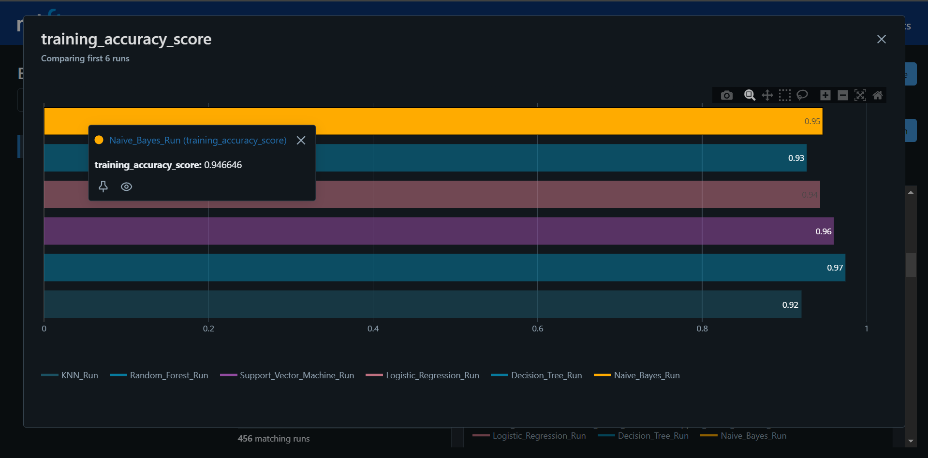

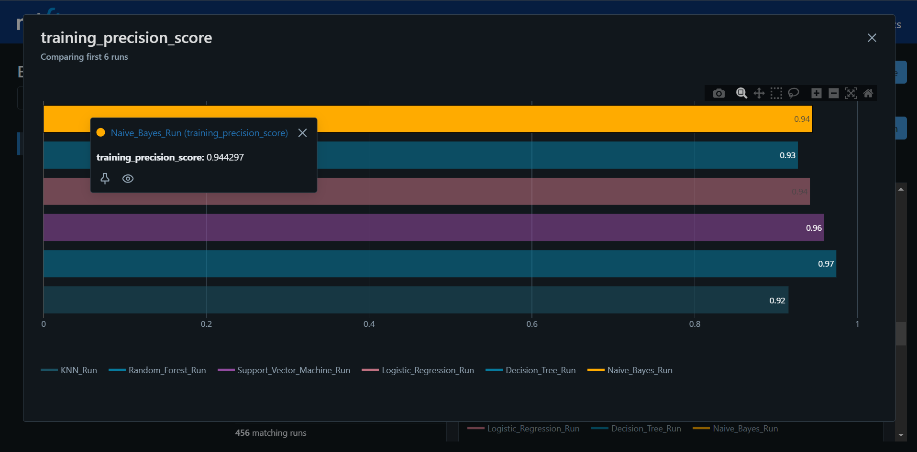
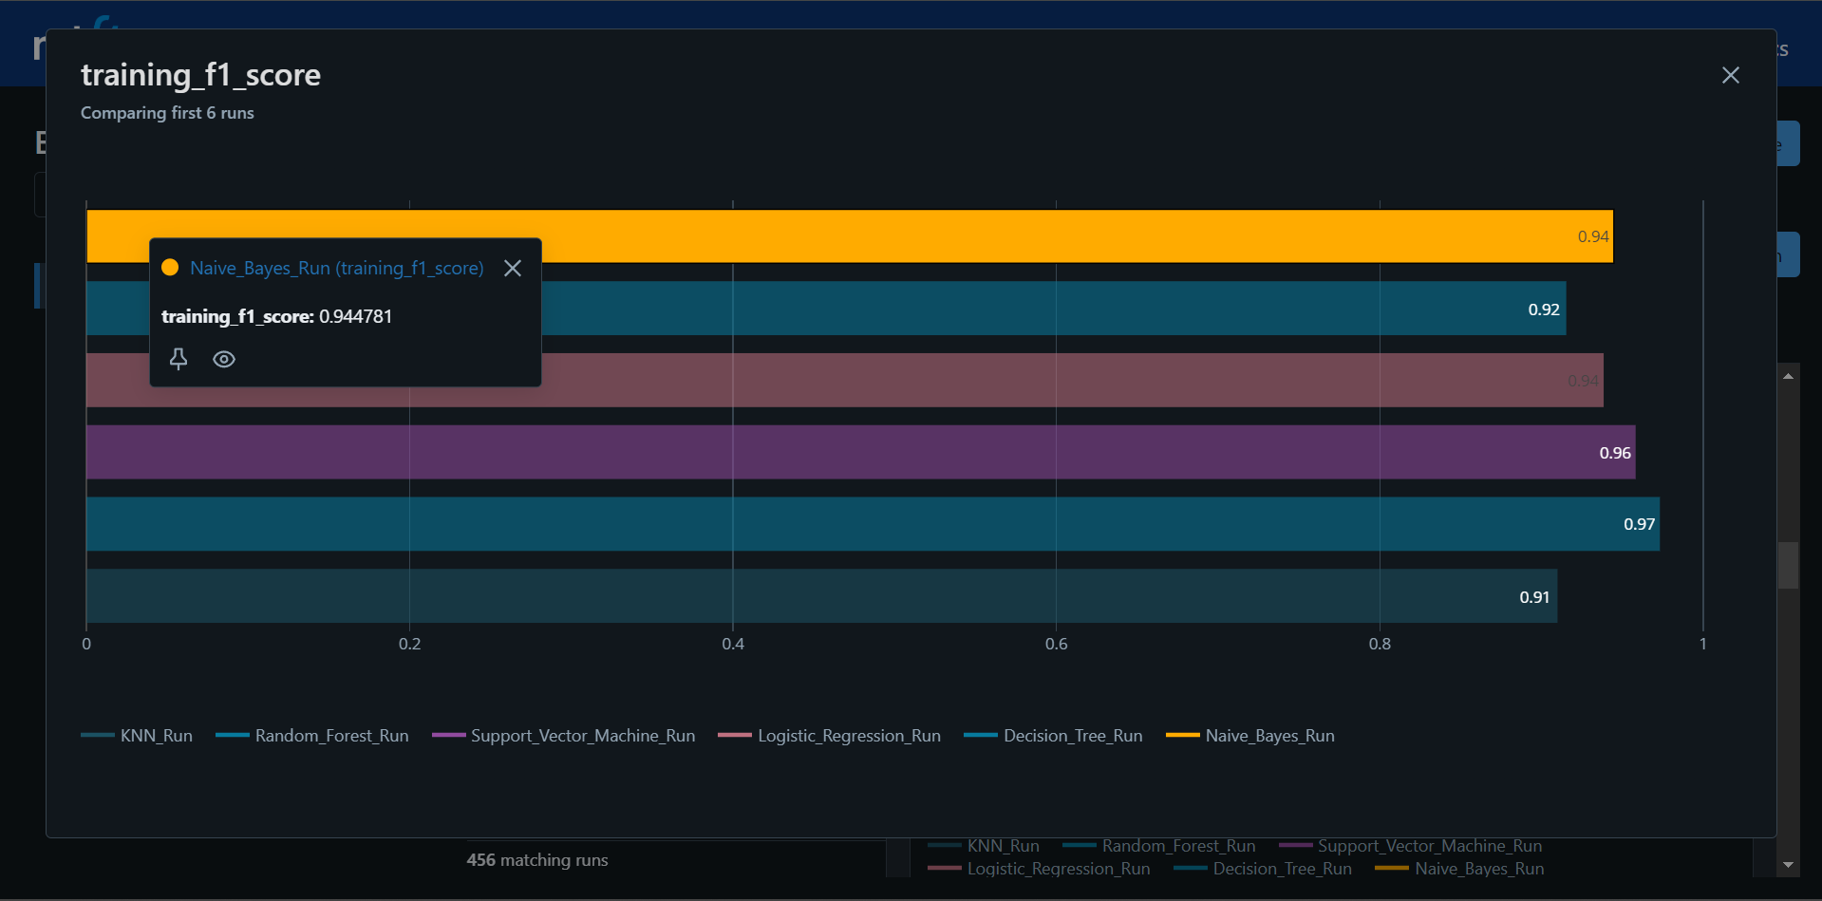
Evaluating metrics

Slide 8
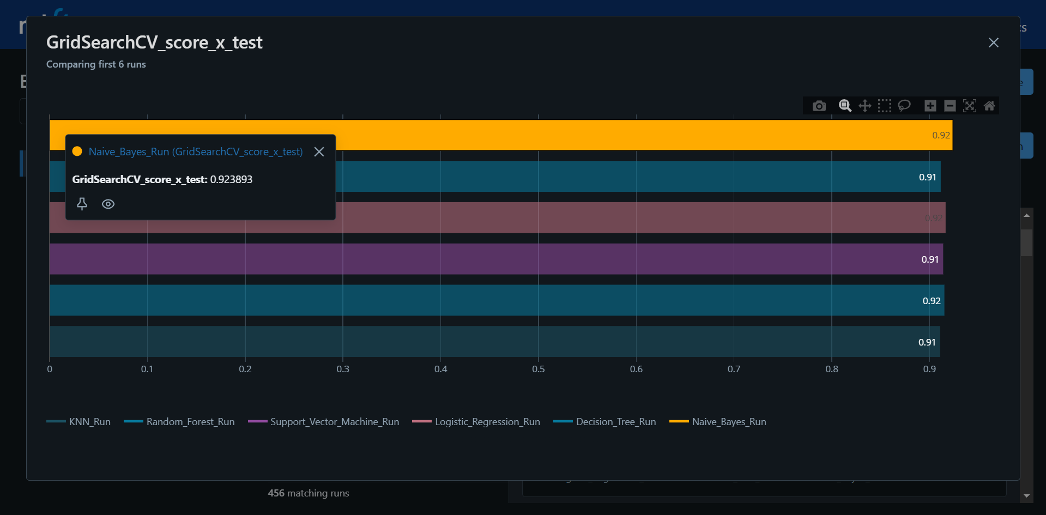
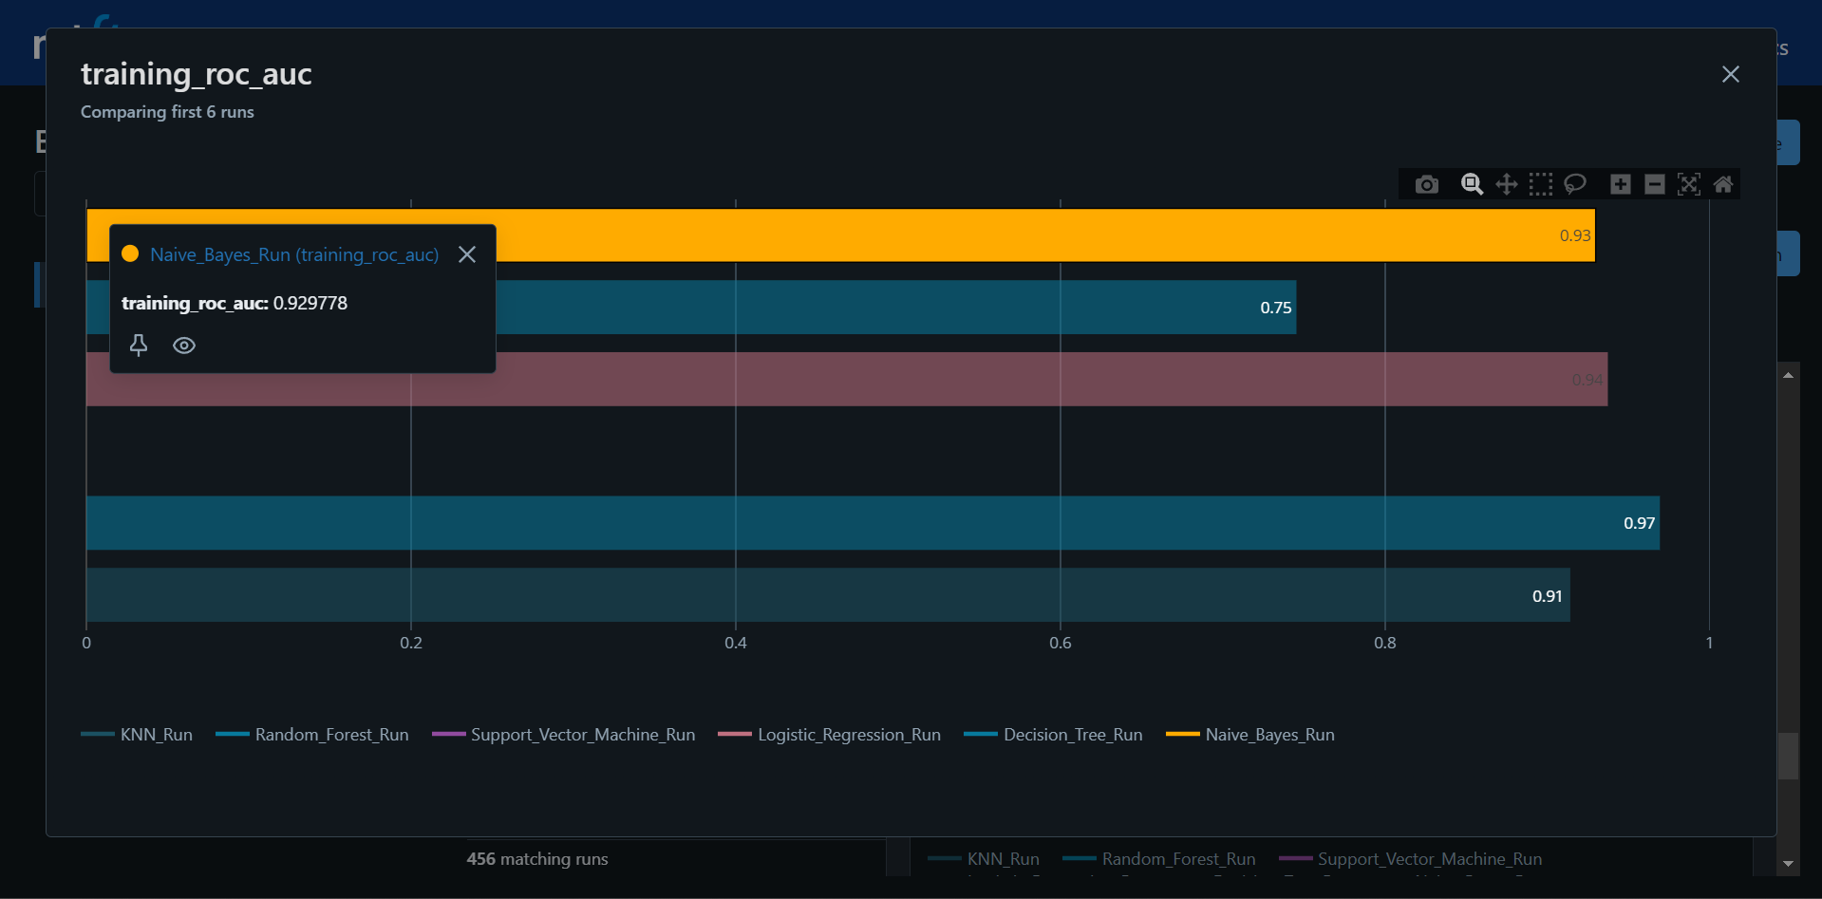
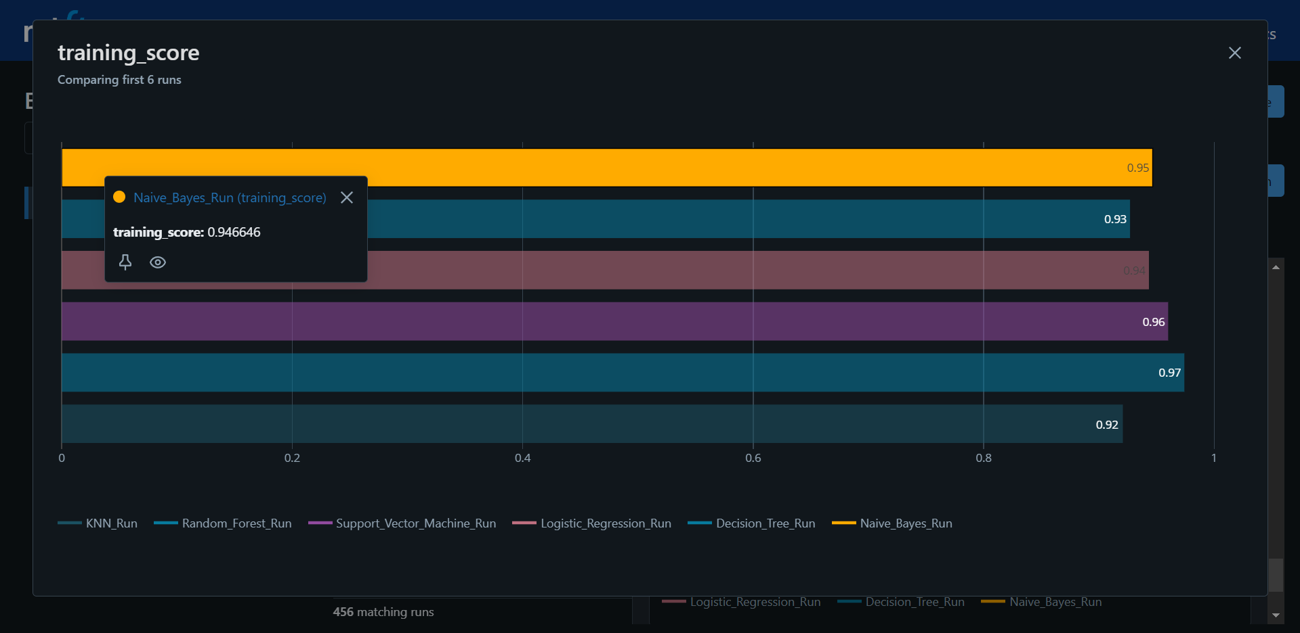

Slide 9
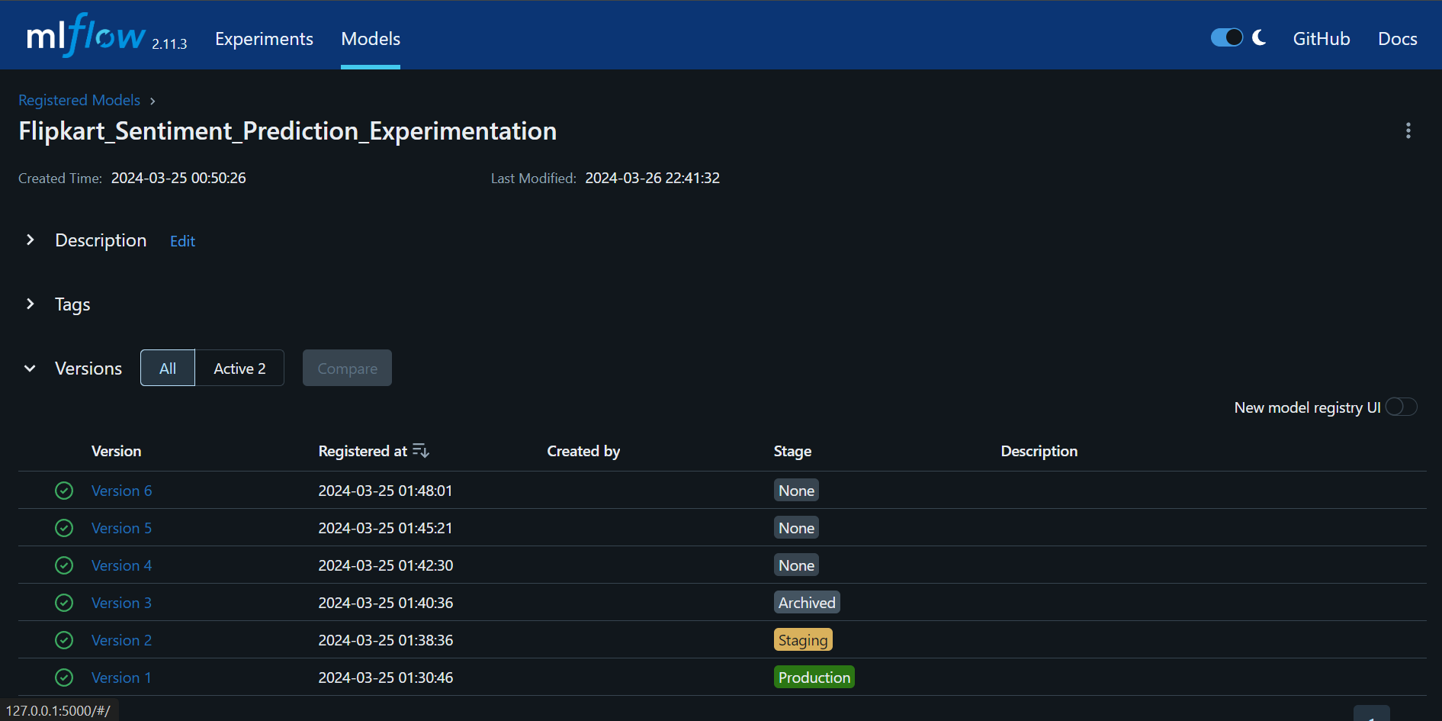
Staging best models for production

Slide 10

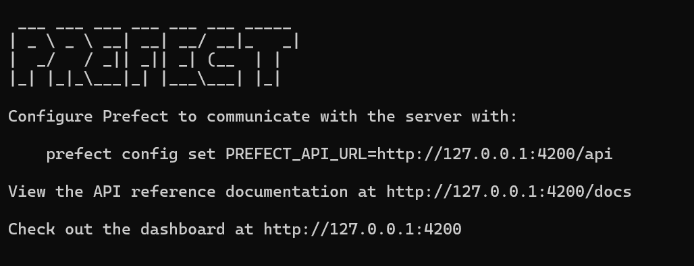


Prefect takes the chaos out of building complex data workflows. Define your machine learning pipelines as code for easy management and version control. Prefect's flexible scheduling and robust monitoring give you unprecedented control and visibility into your ML processes.

Slide 11
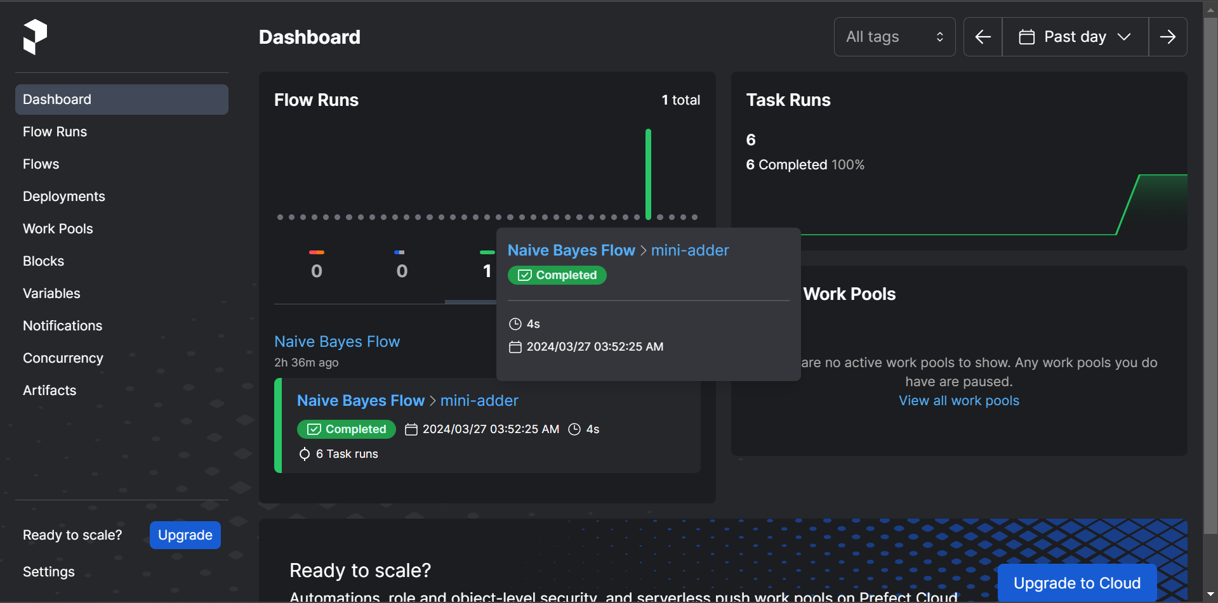
Prefect Dashboard

Slide 12
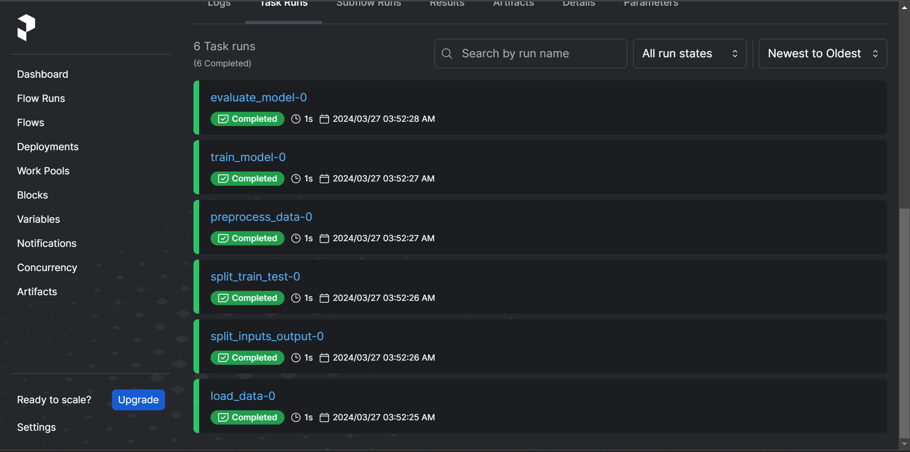
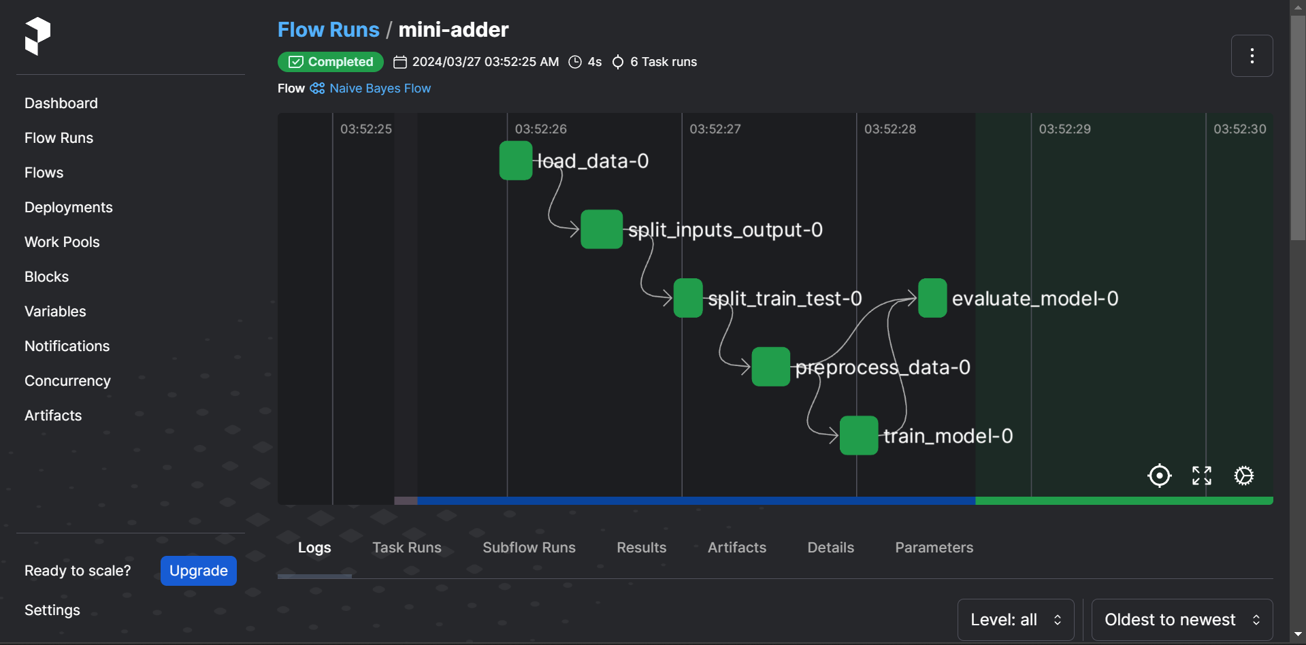
Workflow Tracking

Slide 13


Automating Workflow
Cron :
A powerful tool used to schedule tasks to execute automatically at specific times or intervals.
You define these schedules using special expressions (e.g., "0 5 * * 1" to run every Monday at 5:00 AM)
Prefect Auto-Scheduling :
Prefect integrates with cron, allowing you to schedule your workflows to run on a recurring basis.
This automation ensures your data pipelines run reliably without the need for manual triggering.
Benefits :
Saves time : No need to manually start your workflows.
Consistency : Your processes execute on a predictable schedule.
Focus : You spend less time managing execution and more time on development.

Slide 14
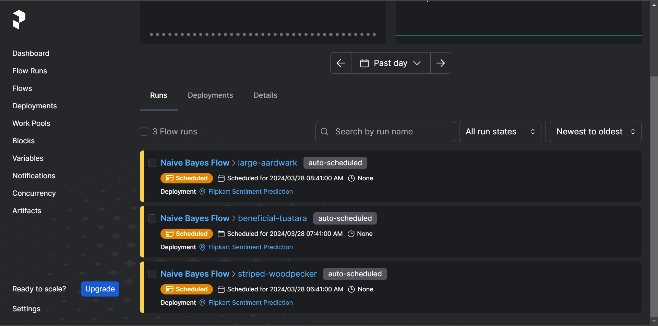
Scheduled runs at specific intervals

Slide 15

THANK YOU

